Slide 1
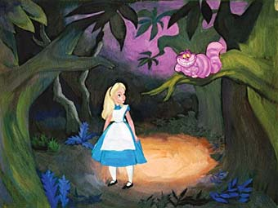


Strategic Planning
“Which way you ought to go, depends on where you’re trying to get too”
Lakewood Resource & Referral Center
212 SECOND STREET, SUITE 204
LAKEWOOD, NEW JERSEY 08701
Notes:
1

Slide 2
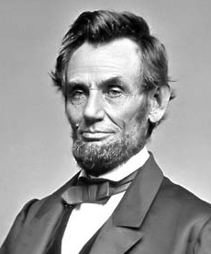

Strategic Planning
“If we could first know where we are and whither we are tending, we could better judge what to do and how to do it.”

Slide 3
The Topics We’ll be Covering
Strategic Planning
What Is It
Scope of Agency Involvement
What does it Accomplish
How is it Done

Slide 4

What Is It
The process of determining a company's long-term goals and then identifying the best approach for achieving those goals
Future
Present
How do we get from here to there

Slide 5
Scope of Agency Involvement
Full and active executive support
Effective communication
Employee involvement
Thorough organizational planning and competitive analysis
Widespread perceived need for the strategic planning

Slide 6
What does it Accomplish
Defines purpose and realistic goals
Makes goals known to stakeholders
Builds consensus about direction
Ensures resources directed to priorities
Establishes ways to measure progress

Slide 7
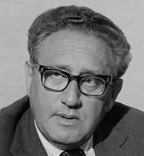

“If we do what is necessary, all the odds are in our favor.”

Slide 8
How is it Done
Three Step Process
Where are we trying to go?
Vision, Mission and Values
Where are we today?
Strategic Analysis
How do we bridge the gap?
Strategic Positioning

Slide 9


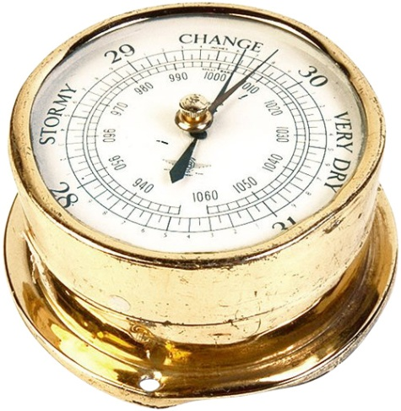
Vision, Mission and Values

Slide 10
Where are we trying to go?
Vision, Mission and Values
Vision Statement
Mission Statement
Values Statement
How my business will impact the Future
What do we do, how we do it
And who do we do it for
What values drive our mission and vision

Slide 11
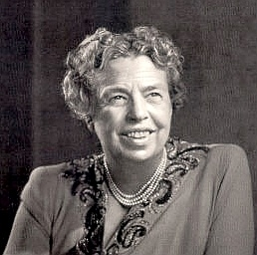


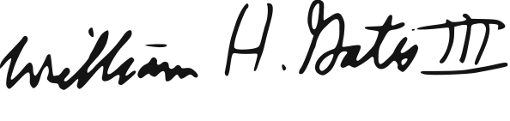
Where are we trying to go?
Vision, Mission and Values
Vision Statement
“The future belongs to those who believe in the beauty of their dreams.”
Why did I start This Business?
“There will be a personal computer on every desk running Microsoft software.”
When I move on from this Place, What do I want to leave Behind?
If My Business could be everything I Dreamed, How would it Be?
What am I really providing for My Customers, Beyond Products and Services?

Slide 12
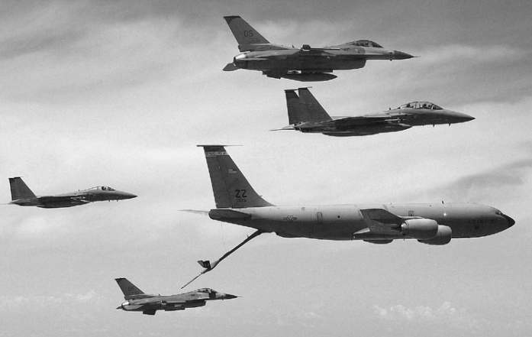
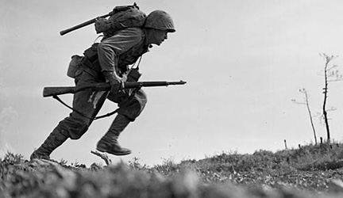
Where are we trying to go?
Vision, Mission and Values
Mission Statement
Why do we Exist?
Who do we Serve
What do we do

Slide 13
Where are we trying to go?
Vision, Mission and Values
Values Statement
What Values are driving our Vision?
What Values are important to the Market we are Targeting?
What are the Values of all the involved Stakeholders
Incorporate these values into the Mission Statement

Slide 14
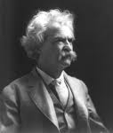
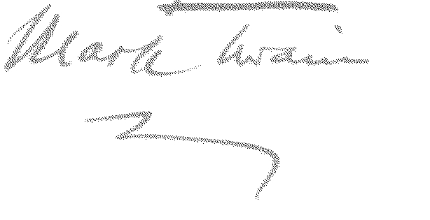
“Why do you sit there looking like an envelope without any address on it?”

Slide 15
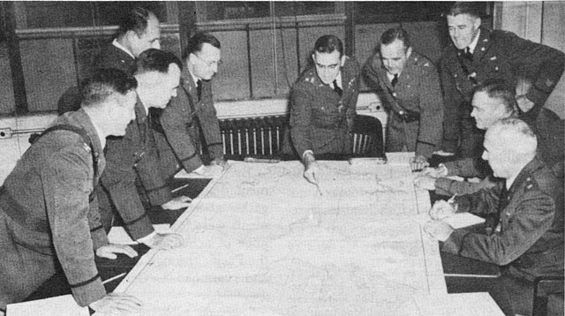
Strategic Analysis

Slide 16
Where are we today?
Strategic Analysis
Understanding the Environment
Macro Environment
Industry Environment
Micro Environment

Slide 17
Where are we today?
Strategic Analysis
Macro Environment
Industry Environment
Micro Environment
What forces contribute to our industry’s growth & contraction
What is the competitive landscape of our industry
What Strengths and weaknesses does our agency have as it relates to the outside environment

Slide 18
Where are we today?
Strategic Analysis
Macro Environment
PEST Analysis
P
Political
E
Economic
S
Social
T
Technological

Slide 19
Where are we today?
Strategic Analysis
Industry Environment
Entrants
Porter’s Five Forces
Competitive Landscape
Suppliers
Buyers
Substitutes

Slide 20
Where are we today?
Strategic Analysis
Micro Environment
Strengths
Weaknesses
Financial
Physical
Intellectual
Social
Financial
Physical
Intellectual
Social

Slide 21
Where are we today?
Strategic Analysis
SWOT
Model
Helpful
Harmful
Internal
Strengths
Weaknesses
This is where we Stand Today
External
Opportunities
Threats

Slide 22
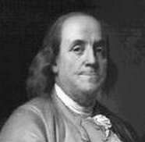

“By failing to prepare,
you are preparing
to fail.”

Slide 23

Strategic Positioning

Slide 24
How do we bridge the gap?
Strategic Positioning
Setting the goals
Developing Action Plans
Communicating the Tasks

Slide 25

How do we bridge the gap?
Strategic Positioning
Setting the goals
Vision
Values
Environment
Mission
Within the Framework of the Vision, Mission and Values
Within the Environment that we Currently are in
Goals
Environment

Slide 26
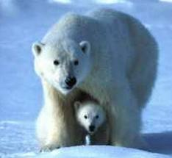
How do we bridge the gap?
Strategic Positioning
Setting the goals
Build on Strengths
BEAR
Resolve Weaknesses
Exploit Opportunities
Avoid Threats

Slide 27
How do we bridge the gap?
Strategic Positioning
SMART Goals
S
Specific
M
Measurable
A
Accountable
R
Realistic
T
Time Based

Slide 28
How do we bridge the gap?
Strategic Positioning
Action Plan
Mission, Vision and Values
Goal 1
Goal 2
Goal 3
Objective
Objective
Objective
Objective
Objective
Objective
Strategies
Strategies
Strategies
Strategies
Strategies
Strategies
Tasks
Tasks
Tasks
Tasks
Tasks
Tasks
Timeline
Timeline
Timeline
Timeline
Timeline
Timeline

Slide 29
How do we bridge the gap?
Strategic Positioning
Logic
Model
Communicating the Goals
Inputs
Processes
Outputs
Outcome
Physical
Financial
Social/ Human
Intellectual
Tasks &
Activities
Strategies &
Objectives
Goals

Slide 30
Summing It all up
How is it done?
What does it Accomplish?
Vision, Mission & Values
What is It?
Strategic Analysis
Strategic Positioning

Slide 31
Thank You
Q&A

Slide 32
Credits
Bryson’s Strategic planning in Public and Nonprofit Organizations
Alliance for Non Profit Management
Management help.org
Dr. Carter McNamara PhD
Venture Philanthropy Partners Publications
The Kellogg Foundation Publications
Clifton Gunderson L.L.P. Publications
Brody Weiss and Burns Publications
Managance Consulting Publications
U.S. Dept of Energy Publications
Municipal Government of Boise, Idaho Publications
Wikipedia
Susan M Heathfield - Heathfield Consulting Associates
Kordell Norton
Thinking More Effectively about Long Term Management of Radio Active Waste – A Visual Analytics approach R.E. Horn, Stanford University 2004
Competitive Advantage – Creating and Sustaining Superior Performance, Michael E. Porter
The Strategy Focused Organization – Robert S. Kaplan, David P. Norton - Harvard Business School Press
Balanced Scorecard Institute
Lewis Carroll – Alice’s Adventures in Wonderland
Lewis Carroll – Through the Looking Glass
Walt Disney Pictures 1951 - Alice in Wonderland
Google Images

